Slide 1
Computer Network
E-mail

Slide 2
Introduction
Electronic mail (also known as email or e-mail) is one of the most commonly used services on the Internet, allowing people to send messages to one or more recipients. Email was invented by Ray Tomlinson in 1972. E-mail systems are based on a store-and-forward model in which e-mail server computer systems accept, forward, deliver and store messages on behalf of users, who only need to connect to the e-mail infrastructure.

Slide 3
E-mail Address
Email addresses (both for senders and recipients) are two strings separated by the character "@" (the "at sign"):
user@domain
The right-hand part describes the domain name involved, and the left-hand part refers to the user who belongs to that domain.
Example: abc@gmail.com

Slide 4
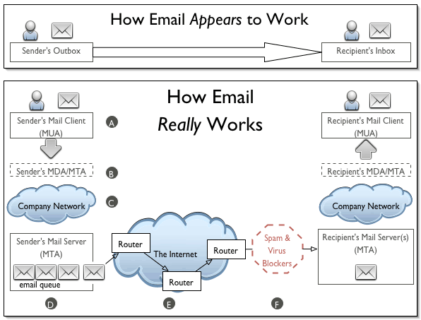
HOW E-MAIL WORKS?

Slide 5
VARIOUS MAIL SERVERS
A mail server (also known as a mail transfer agent or MTA, a mail transport agent, a mail router or an Internet mailer) is an application that receives incoming e-mail from local users (people within the same domain) and remote senders and forwards outgoing e-mail for delivery. A computer dedicated to running such applications is also called a mail server.

Slide 6
Types of mail servers
Generally we use two types of servers to receive and deliver mails are as follows:
SMTP Server
POP Server

Slide 7
SMTP Server
SMTP is a text-based protocol, in which a mail sender communicates with a mail receiver by issuing command strings and supplying necessary data over a reliable ordered data stream channel. SMTP was designed as an electronic mail transport and delivery protocol, and as such it is used between SMTP systems that are operational at all times.

Slide 8
POP Server
The Post Office Protocol (POP) is an application-layer Internet standard protocol used by local e-mail clients to retrieve e-mail from a remote server over a TCP/IP connection. POP and IMAP (Internet Message Access Protocol) are the two most prevalent Internet standard protocols for e-mail retrieval.

Slide 9
Email protocol
HTTP
SMTP
POP3
IMAP

Slide 10
MIMe
MIME is stands for (Multipurpose Internet Mail Extensions). It is widely used internet standard for coding binary files to send them as e-mail attachments over the internet. MIME allows an E-mail message to contain a non-ASCII file such as a video image or a sound and it provides a mechanism to transfer a non text characters to text characters.

Slide 11
The features offered by MIME to email services are as follows:
Support for multiple attachments in a single message
Support for non-ASCII characters
Support for layouts, fonts and colors which are categorized as rich text.
Support for attachments which may contain executables, audio, images and video files, etc.
Support for unlimited message length.

